Slide 1

ETL: Manipulando dados com Pandas
Prof. Dr. Diego Bruno
Education Tech Lead na DIO Doutor em Robótica e Machine Learning pelo ICMC-USP

Slide 2

Leitura de dados
Prof. Dr. Diego Bruno

Slide 3
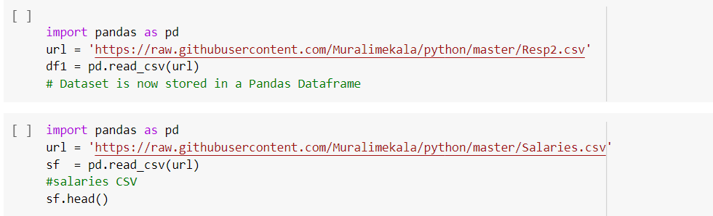
Leitura dos dados
Prof. Dr. Diego Bruno

Slide 4
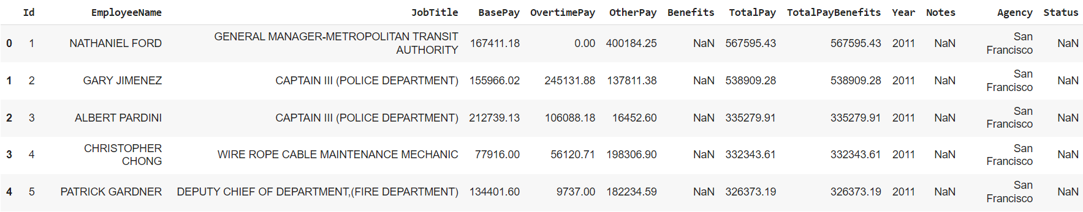
Tabela gerada
Prof. Dr. Diego Bruno

Slide 5
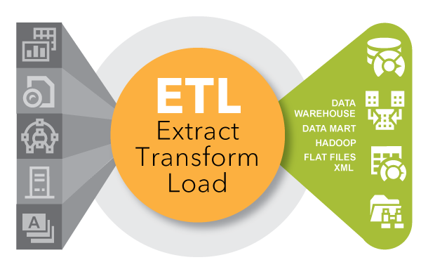
Obrigado!
Prof. Dr. Diego Bruno
Notes:
https://www.youtube.com/watch?v=ns4aMnbW0ok
https://luigi.readthedocs.io/en/stable/
https://www.youtube.com/watch?v=RCdms8eGid8
https://www.youtube.com/watch?v=RCdms8eGid8
https://luigi.readthedocs.io/en/stable/

